Slide 1
Low Cost Neuroprosthetic Arm
Faculty Mentor : Dr. Neha Tiwari
Team Members
Ajinkya Bedekar
Cherla Pradyumna Reddy
Dhruva Agarwal
Arjun Bakshi
Kawal Nain Singh Batra

Slide 2
Idea
To design a low-cost neuro-prosthetic arm, compatible with a variety of patients and which can perform rudimentary motor functions.
It is basically an artificial arm that is controlled by processing the tapped brain signals which then provides the ability to do elementary tasks like picking something up or opening doors.

Slide 3
Motivation Behind This Idea
It has been estimated that there are roughly 0.62 amputees in India per thousand population, .i.e close to one million individuals with amputations in the country.
When a person becomes a limb amputee, he or she is faced with staggering emotional and financial lifestyle changes.
Present neuroprosthetic technology is very costly and unaffordable and also it is scarcely available to many amputees.
Such aids are not really helping the ones in need and has a very little approachability.
There is a serious need for a low cost neuroprosthetic arm which can perform rudimentary motor functions .

Slide 4
Service
To develop a brain-controlled prosthetic arm to enable the disabled to become more independent.
This arm will be controlled directly by the brain of the amputee, just like any other part of their body.

Slide 5
Technology behind the Product
Mostly, the signal pathways between the brain and the limbs are the ones to get disrupted, but the motor cortex and the limb muscles that it controls remain intact.
Research in the field of brain computer interfaces (BCIs) has demonstrated that brain activity in the intact motor cortex can be leveraged to establish a direct, functional connection with any assistive device to restore motor and sensory functions.
Similarly for the amputees, a prosthetic arm can be controlled to perform rudimentary functions with the help of assistive devices.

Slide 6
Technology behind the Product (contd.)
The whole project will be divided into three distinct modules.
First module:
It will comprise of Sensing and Signal Acquisition where the brain signals will be tapped noninvasively. Invasive placement of the module may be considered if the non- invasive method is found unsuccessful.
Second module:
It will comprise of Signal Processing where the tapped brain signals will be processed and analyzed for actuating the further stage of prosthetic limb.
Third module:
It will be the designing of the prosthetic limb and actuating it in accordance with the processed signal coming from the second module.

Slide 7
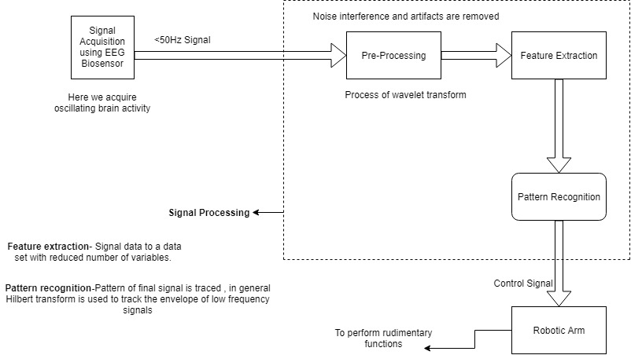
BLOCK DIAGRAM

Slide 8
Possible innovation at a later stage
The idea can be further extended to replace or restore useful functions to people disabled by neuromuscular disorders such as:
Amyotrophic lateral sclerosis (nervous system disease that weakens muscles and impacts physical function)
Cerebral palsy (congenital disorder of movement, muscle tone or posture) or stroke.

Slide 9
The market (the size of the market and its growth potential)
Presently, limbs manufactured per factory has a count of over 60,000 products per year so there is a vast market in this field. This emphasises the need for technological advancement in this field.
This product is intended to reach out to the disabled population who is unable to afford high-end and expensive assisting devices.
We believe that once successfully developed, our product will touch the lives of many unfortunate people.

Slide 10
Comparative Analysis
Products / Features | Speed Runner Artificial Limb Centre, Andhra Pradesh | Biolife, Delhi | Anand Corporate Service, Ghaziabad | College Park Radsun Artificial Limb Clinic, Hyderabad | Our Product
Degree 1 (Fingers’ Movement) | ✔ | ✔ | ✔ | ✔ | ✔
Degree 2 (Elbow Movement) | X | ✔ | X | ✔ | ✔
Degree 3 (Wrist Movement) | X | ✔ | X | ✔ | X
MRP (₹) | 1,52,000 | 2,52,000 | 1,50,000 | 3,00,000 | 1,50,000 (max.)

Slide 11
THE FINANCIAL REQUIREMENT (may not be restricted to DST support)
The cost of purchase of raw materials: - ₹ 1.45 Lakhs /-
BCI custom Kit (OpenBCI Bundle) – ₹ 55,000 /-
Microcontroller – ₹ 3,500 /-
Motors (Hybrid Servo Motor 2-Phase 22kg-CM 1000 Line Encoder and 40mm Worm Reduction Gearbox with Output Flange HK40 including 250W Motor Controller) (x20) – ₹ 75,000 /-
Wireless Module (REES52 Bluetooth Transceiver Module with TTL Outputs HC05) – ₹ 1,500 /-
3-D Printing – ₹ 10,000 /-
The cost of contingencies: - ₹ 15,000 /-
Product development cost/Consultancy cost: - ₹ 20,000 /-
Any other expenditure(misc.): - ₹ 15,000 /-
Surplus: - ₹ 55,000 /-
Note: The above determined prices have been approximated to the best of our knowledge.

Slide 12


